Slide 1
British Airways
Data Science Project
Module 02

Slide 2
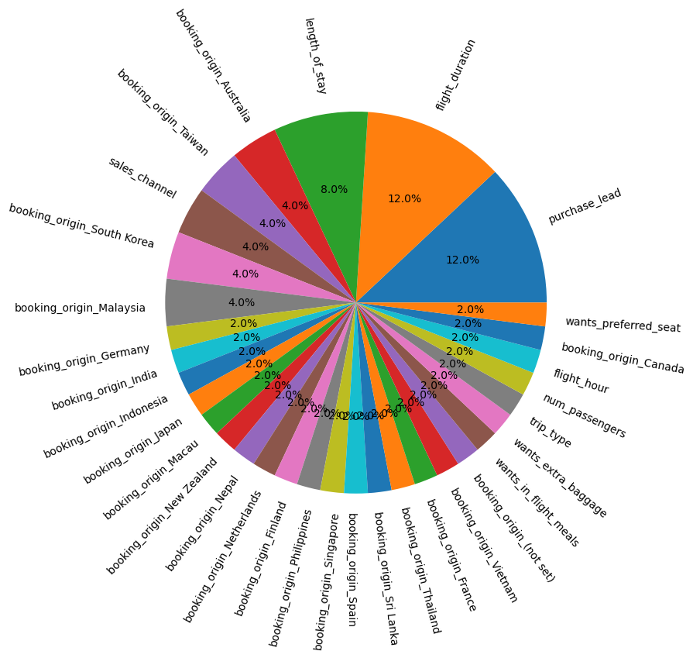
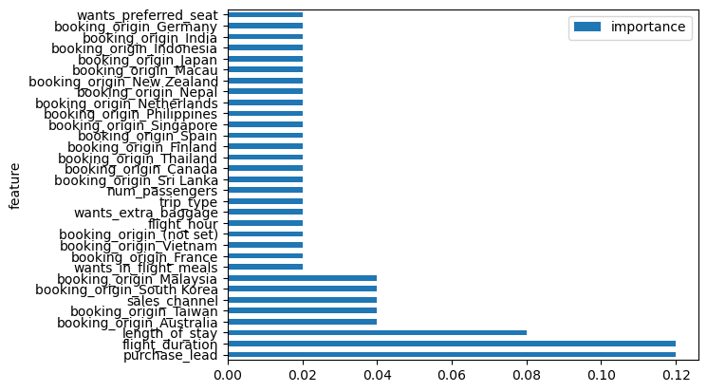
Predictive model Performance
Accuracy: 70.85
F1-Score: 71.24
Precision: 70.22
The dataset was made balanced by Oversampling and under sampling, but results are better with under sampling.
For prediction, AdaBoostClassifier with DecisionTreeClassifier was used
Important Features Which are affecting Bookings

